Slide 1
Advanced Image Processing
Manchester Bioinformatics Course
Andrew Green

Slide 2
The Plan
Recap
Loading data
Image processing
Image registration
Image display for fusion
Manual image fusion
Loading DICOM into python
Cost function
Automatic image fusion
Intro to the practical
Notes:
Lots of recap from the past two days:
How to load data (numpy and images)
Some key bits of image processing from yesterday
Recap of Eliana’s lecture this morning
Brief recap of DICOM
Intro to two libraries we will ue to load DICOM
How to use matplotlib for displaying image fusion
Matplotlib interactivity and writing a manual image fusion code
What is a cost function – recap from this morning
Putting the two together – automatic image fusion
This afternoon’s practical

Slide 3
Loading data
Remember the key functions for loading data:
Images: io.imread
CSV files: np.loadtxt
Flatten colour images to make them black & white
Averages colour channels
Optional argument as_gray=True to imread
Specify delimiter for loadtxt
CSV files will be delimiter=‘,’
Notes:
Later I’ll show how to load and display an image from DICOM

Slide 4
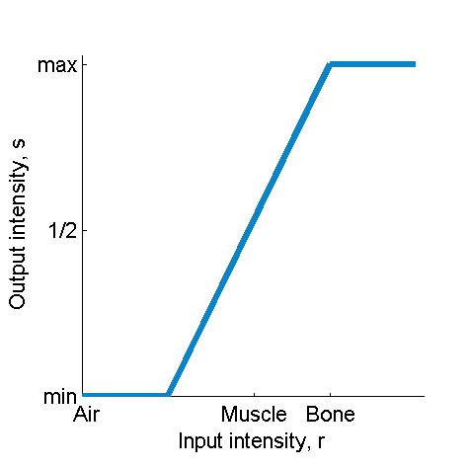

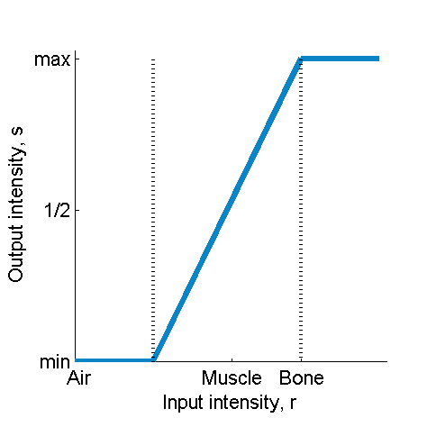
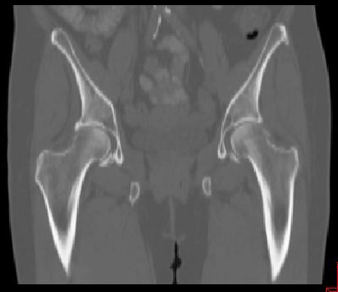
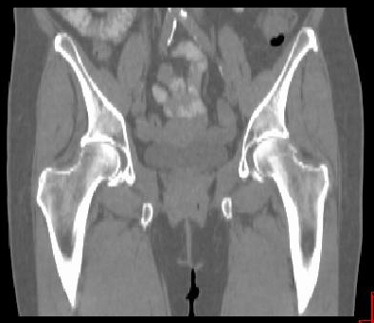
Intensity transformations: Window/Level
Window/level can also be represented as intensity transformation → piece-wise functions
Input image
Function
Output image
?
Window*
Level
* 2x window in some applications
Notes:
Window/level can also be expressed as an intensity transformation

Slide 5
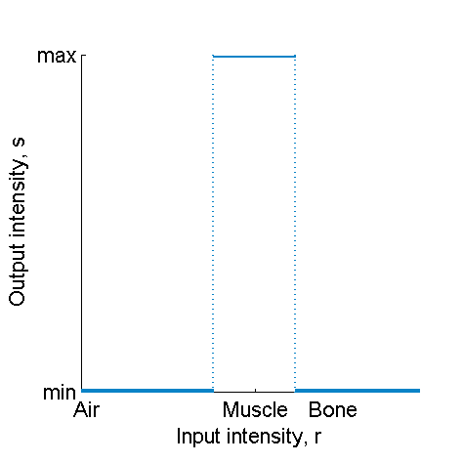
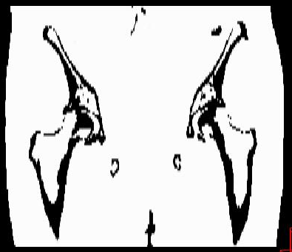
Intensity transformations: Threshold
Simplest image segmentation!
Input image
Function
Output image
Notes:
We could use the window/level to look in the image to find the region we are interested in, then construct a threshold to select only that region
We will be doing pretty much that in the practical later

Slide 6
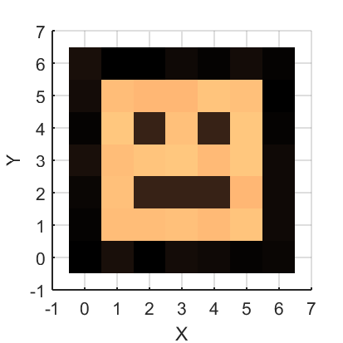
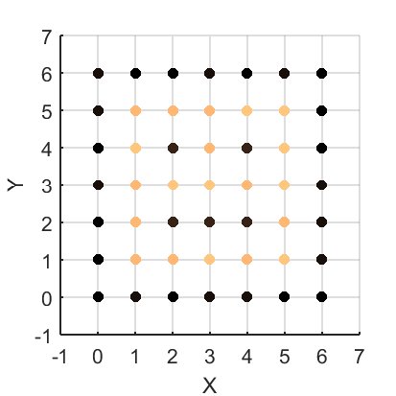
Image as Points + Intensity Value
Besides the intensity value, every pixel has a set of coordinates (x,y) e.g. (5.0, 4.0)
Spatial transformations are applied to the pixel coordinates!
This is all handled by ndimage.interpolate
(and ndimage.rotate)
→ 3D add a new coordinate: z, and T becomes a 4x4 matrix!!

Slide 7
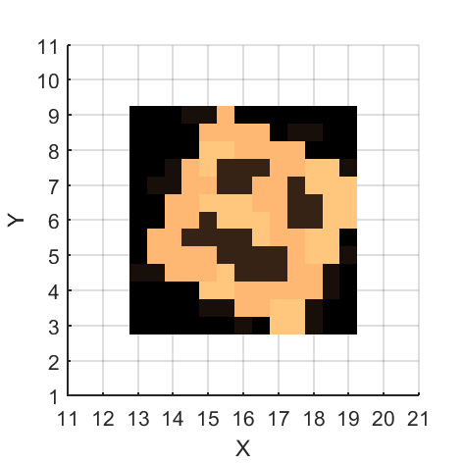
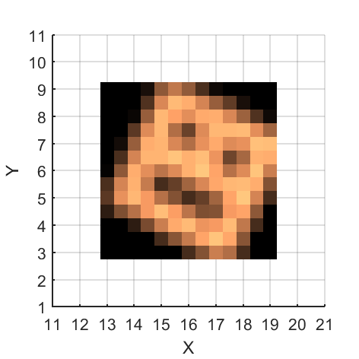
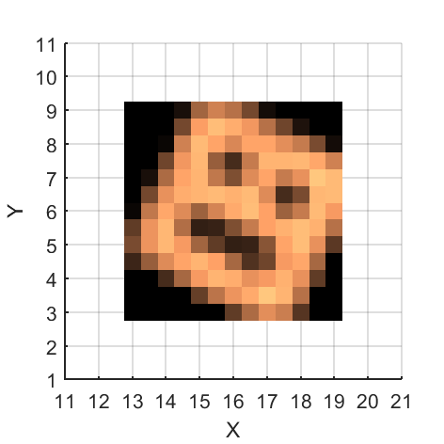
Comparing Interpolators
Nearest neighbor
Simplest, fast, less accurate
Linear
Polynomial
Bit more complicated, slower, ‘more accurate’

Slide 8
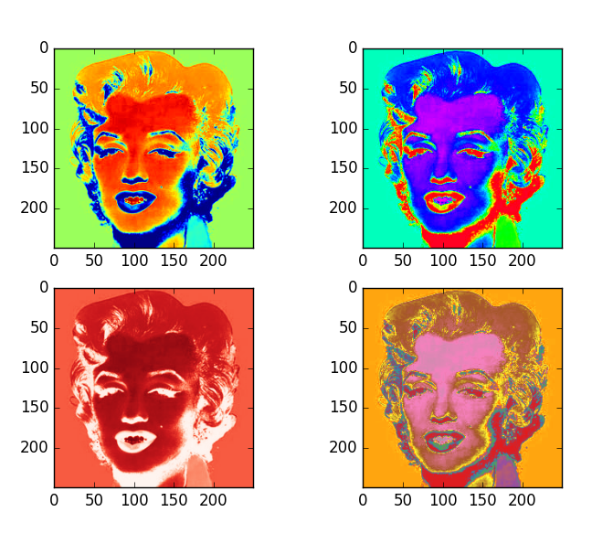
Displaying Images
We are using imshow from matplotlib
Used it a lot yesterday
Colour maps can be specified with e.g. cmap=“Greys_r”
The alpha option sets the transparency of an image
Can also be used in other plots
Notes:
Imshow is really useful, there are other packages (e.g. scikit-image viewer) but we will stick with this one
Anyone know/remember what the _r means in these colour map names?

Slide 9
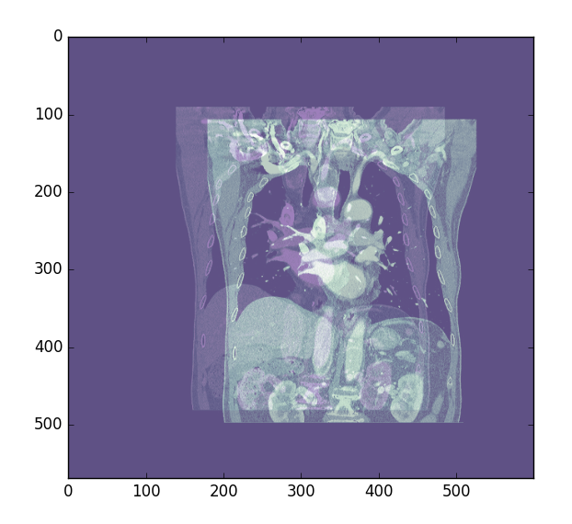
Displaying Images for fusion
The most common display for image fusion is green/purple
One image uses cmap=“Green_r”, the other has cmap=“Purple_r”
Also have to have some transparency
Notes:
Green/purple makes it easy to see when the two are overlapped properly
Transparency is needed because you have one image in front of the other
Should be familiar – I think Mat covered this in the previous lecture

Slide 10
Manual Fusion
To do our image analysis, we need the images to overlap
Line up anatomy on anatomy
Simplest way is to register the images manually by eye
Wrote a fusion code yesterday
Works fine for rigid registration
What happens if the patient changes shape?
We won’t be dealing with this problem!
Notes:
Should have started this in the practical yesterday
- Probably have a simple 2D manual registration already

Slide 11
Manual Fusion in python
def manualRegister(event):
if event.key == “up”:
# Move the image up
elif event.key == “down”:
# Move the image down
…
elif event.key == “alt+left”:
# rotate the image?
# Somewhere in the code...
cid = fig.canvas.mpl_connect('key_press_event', manualRegister)
To be able to do manual fusion, we made interactive plots.
This is done in matplolib with ‘event handlers’
You did this in the practical yesterday
Notes:
This slide may not be needed

Slide 12
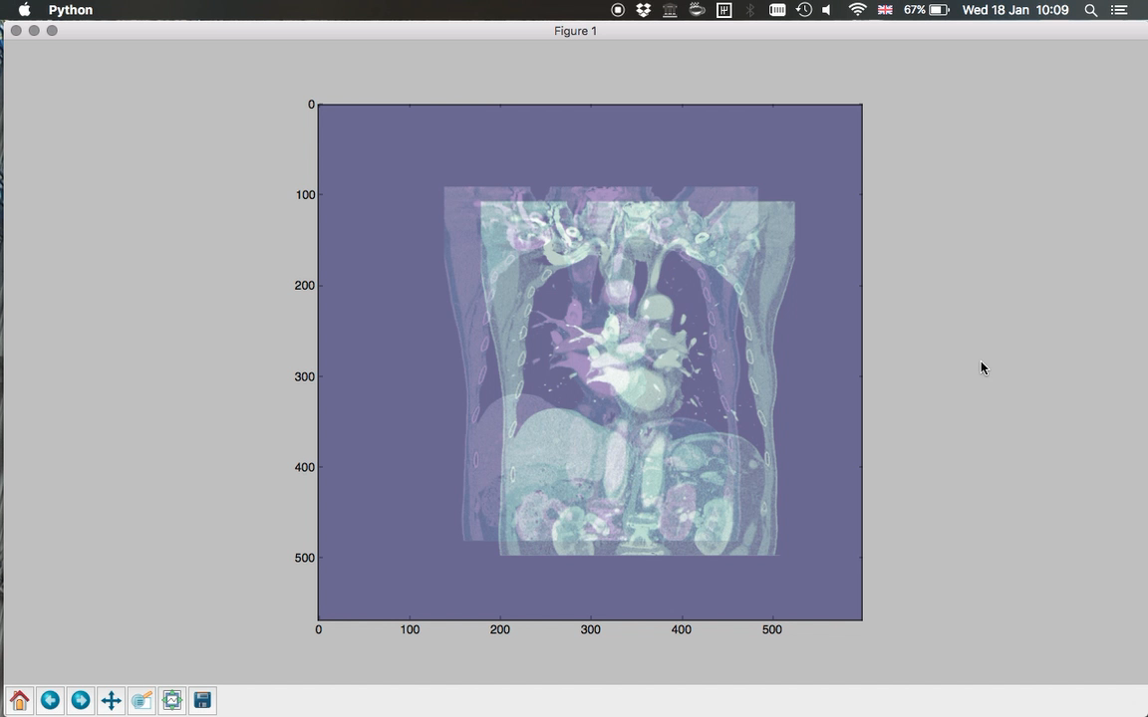
Notes:
Matplotlib event handlers can deal with combo keys as well – just put what you think it should be
Moving/rotating the image is left for the user to implement
You could also try implementing a mouse pick and drop version – it is quite similar

Slide 13
DICOM

Slide 14
Loading DICOM in python
Recap: DICOM is a file format and communication standard.
The DICOM specification is very complicated
Huge and constantly evolving
Optional fields make writing a DICOM reader difficult.
Python has two libraries:
pydicom – main DICOM library
pynetdicom – For connecting to DICOM servers
Notes:
Recap to Marcel’s lectures on Monday
DICOM standard has 20 volumes, each of which is multiple hundreds of pages.
Everyone’s idea of valid DICOM is different! (different versions)
DICOM is a really difficult image format to read because many fields are optional, but you still have to handle them
Pydicom is great, but not everything works (compression) – test it with your images and be ready for glitches!
May have used it yesterday

Slide 15
pydicom Example
import pydicom
import matplotlib.pyplot as plt
patientImage = pydicom.dcmread(“IMG-0004-00001.dcm”).pixel_array
plt.imshow(patientImage)
plt.show()
Notes:
This is simply loading a single slice from CT, then displaying it in an imshow window
Note – import dicom! Not pydicom

Slide 16
Loading multiple slices
A 3D CT is made of many axial slices
Loading a 3DCT with pydicom is the same as loading a single slice
Just point to the directory instead:
patientImage = pydicom.dcmread(“<path to folder>”)
The output of dcmread is a dicom object
pixel_array is the image
Also contains other DICOM tags

Slide 17
Automating Registration

Slide 18
Cost Functions
A cost function is just a function that tells you how bad the match is
Also known as a metric
Look at the two images, how much do they overlap?
How might you measure it?
Sum of square differences (simple and effective!)
Cross entropy
Mutual information
Notes:
Eliana covers this in her lecture
For us, a cost function will literally be a function that tells us how bad a match is as a number
Why is the straight difference between images a bad cost function?
It can be negative
It is not very sensitive
Sum of square differences is easy to implement, and sensitive enough
Cross entropy is used in machine learning and other areas – why is it not so good for use with CT images?

Slide 19
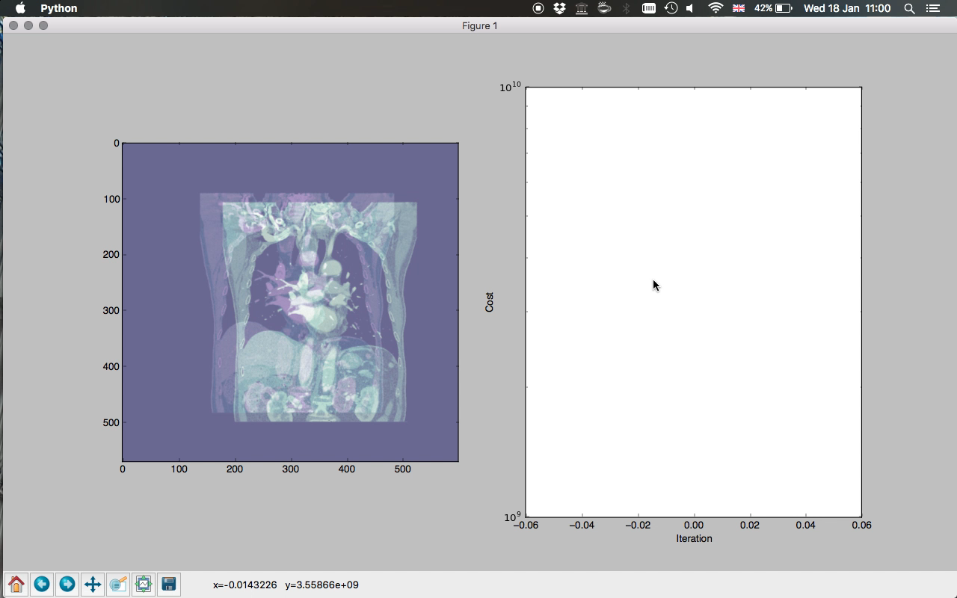

Slide 20
Cost Functions
def costFunction(image1, image2):
“””
Returns a cost function based on the two images
“””
return np.mean((image1 – image2)**2)
What is this cost function called?
Notes:
Some python code showing a cost function
Show how the cost function changes as you scan across a simple image

Slide 21
Automatic Fusion
Manual fusion is useless for large datasets
Need to register thousands of images
Not practical manually
Also too time consuming/inaccurate for clinical use
Use cost function to enable automatic registration
Need to check the accuracy of your registration somehow
Notes:
It takes maybe 30s per slice to do manual fusion
The accuracy is poor
It is not repeatable
It takes too long
We can use the cost function and the shifting to do registration automatically

Slide 22
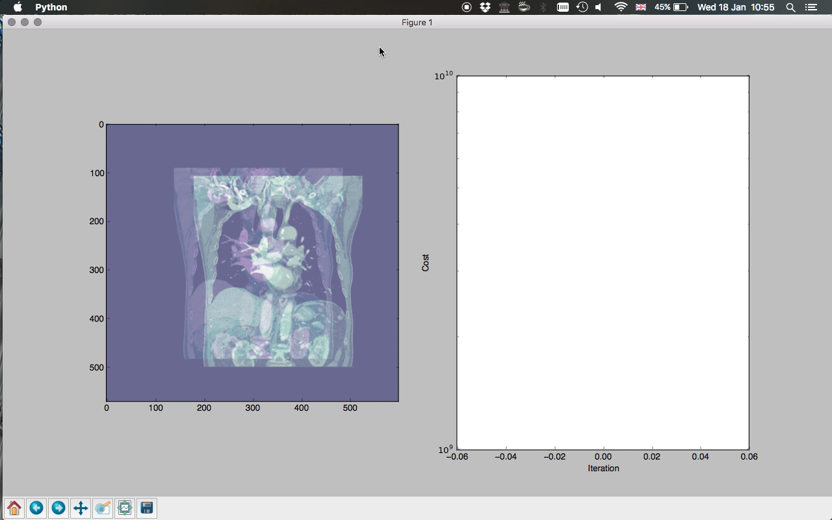
Notes:
What optimisation algorithm is this?

Slide 23
Automatic Fusion
Automatic fusion is just an optimisation problem
Minimising the cost function
Optimisation is a tricky subject…
Fortunately python has a library for this!
scipy.optimize
scipy.optimize contains many algorithms
We will be testing a few of them later
Notes:
Optimisation is a well-studied area in computing
Minimising a function is a well defined problem
Optimisation is in general hard
Many algorithms
Easy to make mistakes
Scipy.optimize already has many popular algorithms, and we can mangle our code to use it

Slide 24
Automatic Fusion – python skeleton
def shiftImages(shifts, opt. arguments to update plot ):
# Interpolate & rotate image
# test if opt. args are present, update plot
# if they are
# Do a brute force optimisation (for example)
res = brute(shiftImages ((xLow, xHi),(yLow, yHi)))
# do a final plot update call to shift the images
# Note – it’s a different function!
shiftImages2(res, < opt. args. >)
Notes:
This is a skeleton code for how we will implement automatic fusion in python this afternoon
I’ll show what optional arguments are in the practical, and how to use them

Slide 25
Automatic fusion
Yesterday we made the manual fusion code
Wrote two functions: eventHandler and shiftImages
We should be able to repurpose that code now to use in automatic fusion.
That’s why we wrote it like that!
However, a couple of changes will be needed…

Slide 26
Automatic Fusion
Manual fusion
Take individual small steps
A step is in x or y, not both
Update the global image after each step
Update a plot after every step
Automatic fusion
Move image in large shifts
Shift is a 2D vector (i.e. x and y)
Need to start from the same location every time
Don’t usually update a plot

Slide 27
Automatic fusion
So, the changes we will need to make:
Get rid of global floating image, update from start every time
Get rid of plot updating (can leave it in if you want but it will slow things down)
Make sure shiftImages can handle a tuple rather than two arguments
i.e def shiftImage(vec): rather than shiftImages(x,y):
And some other changes!

Slide 28
Cropping an image
We saw yesterday how to crop parts of an image
Use numpy array slicing, eg image[100:200, 100:200]
Today we will use an interactive method to get the indices, and crop a region of image
Code is already written!
You just need to link up the event handlers to the right event

Slide 29
What we haven’t mentioned
So far we have done rigid registration
Assumes the patient is exactly the same shape in each image
To do proper image analysis, we need to use deformable registration
Allows us to handle weight loss and other changes
Implementation is a bit beyond this course!
Use a library like SimpleElastix if you need it

Slide 30
This afternoon’s practical
Hopefully, as we treat a patient, the tumour shrinks
Part of the treatment is frequent imaging, so we should be able to observe the tumour shrinkage
Your task:
Write an automatic image fusion code
Use it to fuse a set of images
Extract tumour shrinkage information
Notes:
Tumour shrinkage is a useful thing to keep track of
Tells us if the treatment is working
Either CBCT or full CT imaging is done regularly
Using the data, we can look at tumour shrinkage as a function of time
We will write some code to get patient images, fuse them and extract tumour area/volume

Slide 31
This afternoon’s practical
You will need:
DICOM image loading
Image display in green/purple
Manual image fusion
Cost function
Automatic image fusion
Cropping
Thresholding
Notes:
We have most of these parts from previous practicals
Now we put it all together to measure something useful.

Slide 32
More resources
An ebook about python: https://automatetheboringstuff.com/
StackOverflow – the answer to pretty much any question is here: http://stackoverflow.com/questions/tagged/python
StackOverflow Documentation – a Wikipedia-like documentation of python (and loads of other languages) http://stackoverflow.com/documentation/python/topics
List of cool python libraries/scripts: https://github.com/vinta/awesome-python
Numpy documentation: https://docs.scipy.org/doc/numpy/

Slide 33
See you in the practical!

